Slide 1
THE INTERACTION

Slide 2
MODELS OF INTERACTION
Donald Norman’s Interaction Model (execution/evaluation cycle)

Slide 3
Some terms of interaction
domain – the area of work under study
  e.g. graphic design
goal – what you want to achieve
  e.g. create a solid red triangle
task – how you go about doing it
– ultimately in terms of operations or actions
  e.g. … select fill tool, click over triangle
Note …
  traditional interaction …
  use of terms differs a lot especially task/goal !!!

Slide 4
Donald Norman’s model
Seven stages
  user establishes the goal
  formulates intention
  specifies actions at interface
  executes action
  perceives system state
  interprets system state
  evaluates system state with respect to goal
Norman’s model concentrates on user’s view of the interface

Slide 5
execution/evaluation loop
    user establishes the goal
    formulates intention
    specifies actions at interface
    executes action
    perceives system state
    interprets system state
    evaluates system state with respect to goal
goal
execution
evaluation
system

Slide 6
execution/evaluation loop
    user establishes the goal
    user formulates intention
    specifies actions at interface
    executes action
    perceives system state
    interprets system state
    evaluates system state with respect to goal
goal
execution
evaluation
system

Slide 7
execution/evaluation loop
    user establishes the goal
    formulates intention
    specifies actions at interface
    executes action
    perceives system state
    interprets system state
    evaluates system state with respect to goal
goal
execution
evaluation
system

Slide 8
execution/evaluation loop
    user establishes the goal
    formulates intention
    specifies actions at interface
    executes action
    perceives system state
    interprets system state
    evaluates system state with respect to goal
goal
execution
evaluation
system

Slide 9
execution/evaluation loop
    user establishes the goal
    formulates intention
    specifies actions at interface
    executes action
    perceives system state
    interprets system state
    evaluates system state with respect to goal
goal
execution
evaluation
system

Slide 10
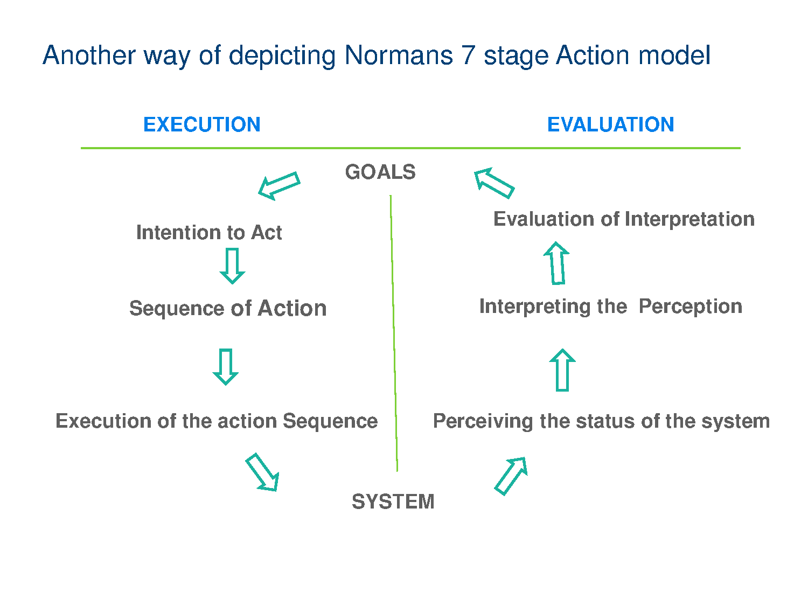

Slide 11
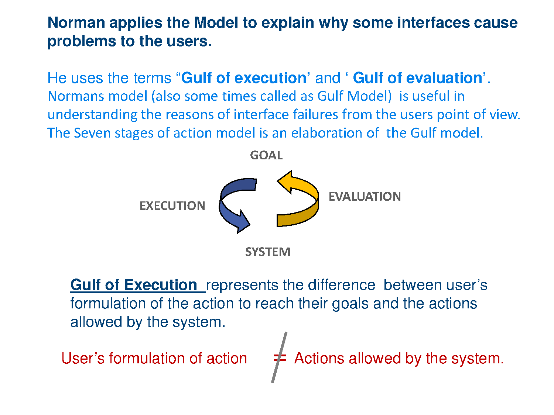
(Application of ‘7’ stages mode)l

Slide 12
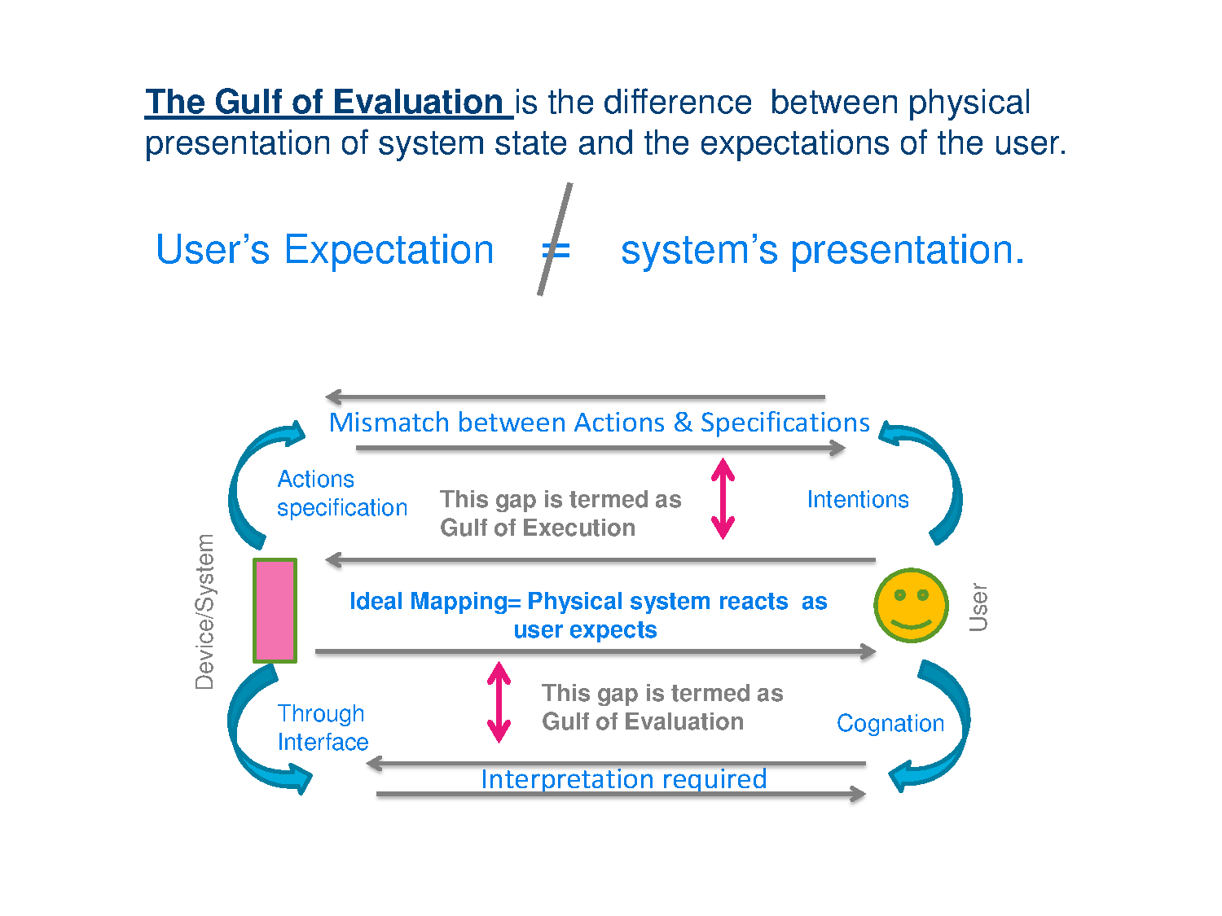

Slide 13

Human error – Errors using an interface
slip
  understand system and goal
  correct formulation of action
  incorrect action
mistake
  may not even have right goal!
Fixing things?
slip – better interface design
mistake – better understanding of system

Slide 14
Gulf of execution: is the distance between the user's goals and the means of achieving them through the system
When problems in the execution phase occur, the "gulf of execution" widens
Here, the distance between the users' goals and their ability to use the system increases
Some examples:
  "What do I do now?"
  "How do I [...]?"
  "I wanted to [...], but I can't see how I would do that?"
  "Do I press this?"
  "Do I type this in here?"
  "I'm looking for [...] but I can't find it"
Gulf of evaluation: the amount of effort required to determine the system state
  When problems occur in the evaluation phase, the "gulf of execution" widens
  Here, the distance between the system response and the users' goals widens
  Some examples
    "What happened then?"
    "What did I do wrong"
    User repeats the action (e.g. clicks the NEXT or SUBMIT button)

